Slide 1
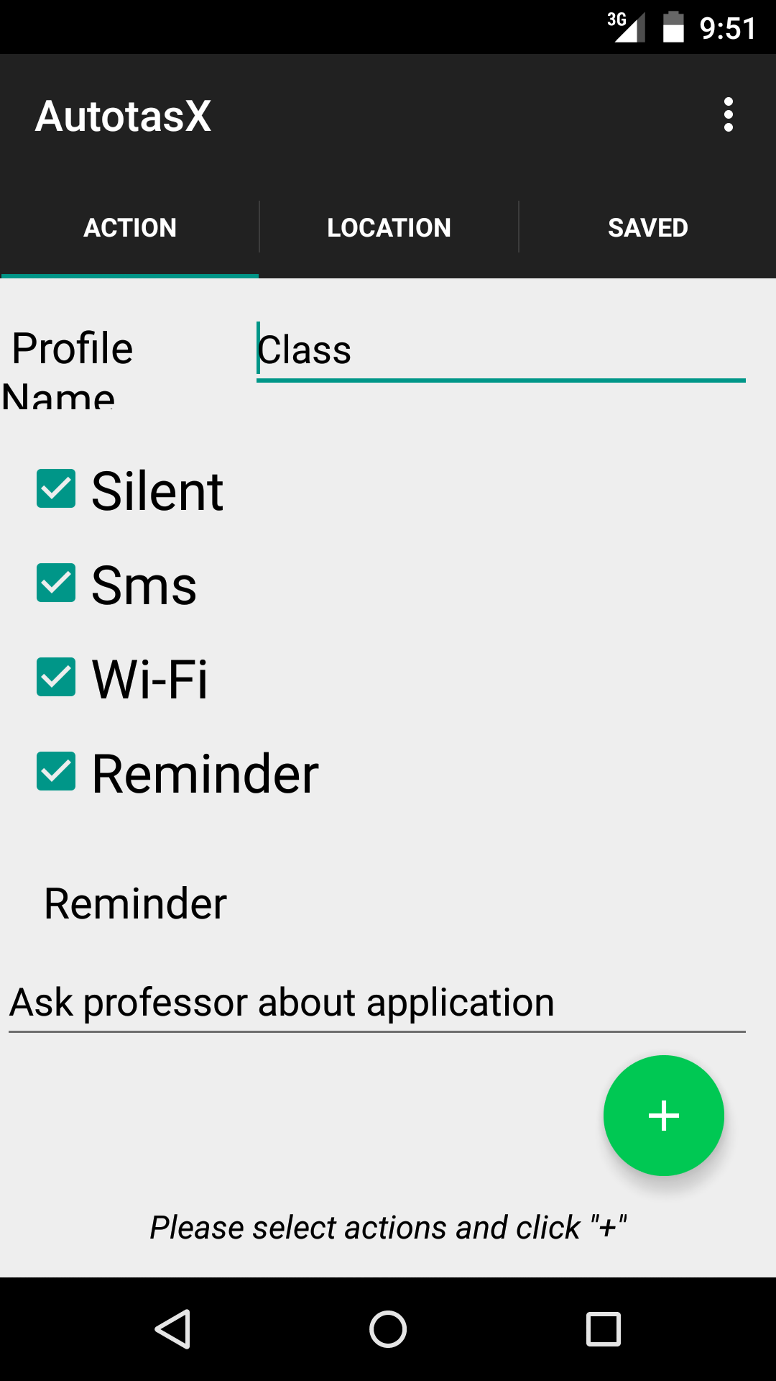
Code Walkthrough
Database Creation
Background functions for actions.

Slide 2
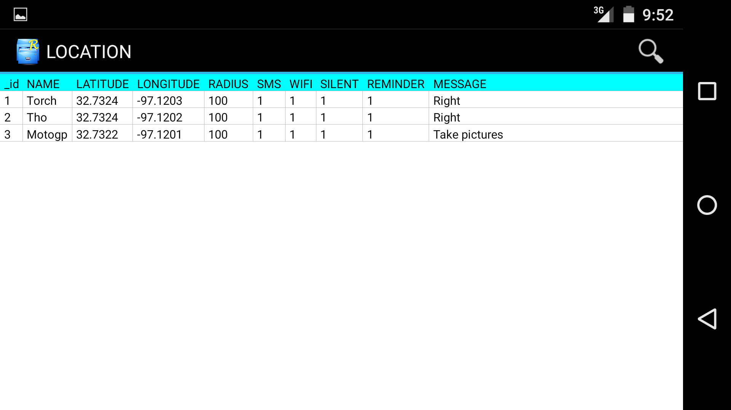
Code Walkthrough

Slide 3
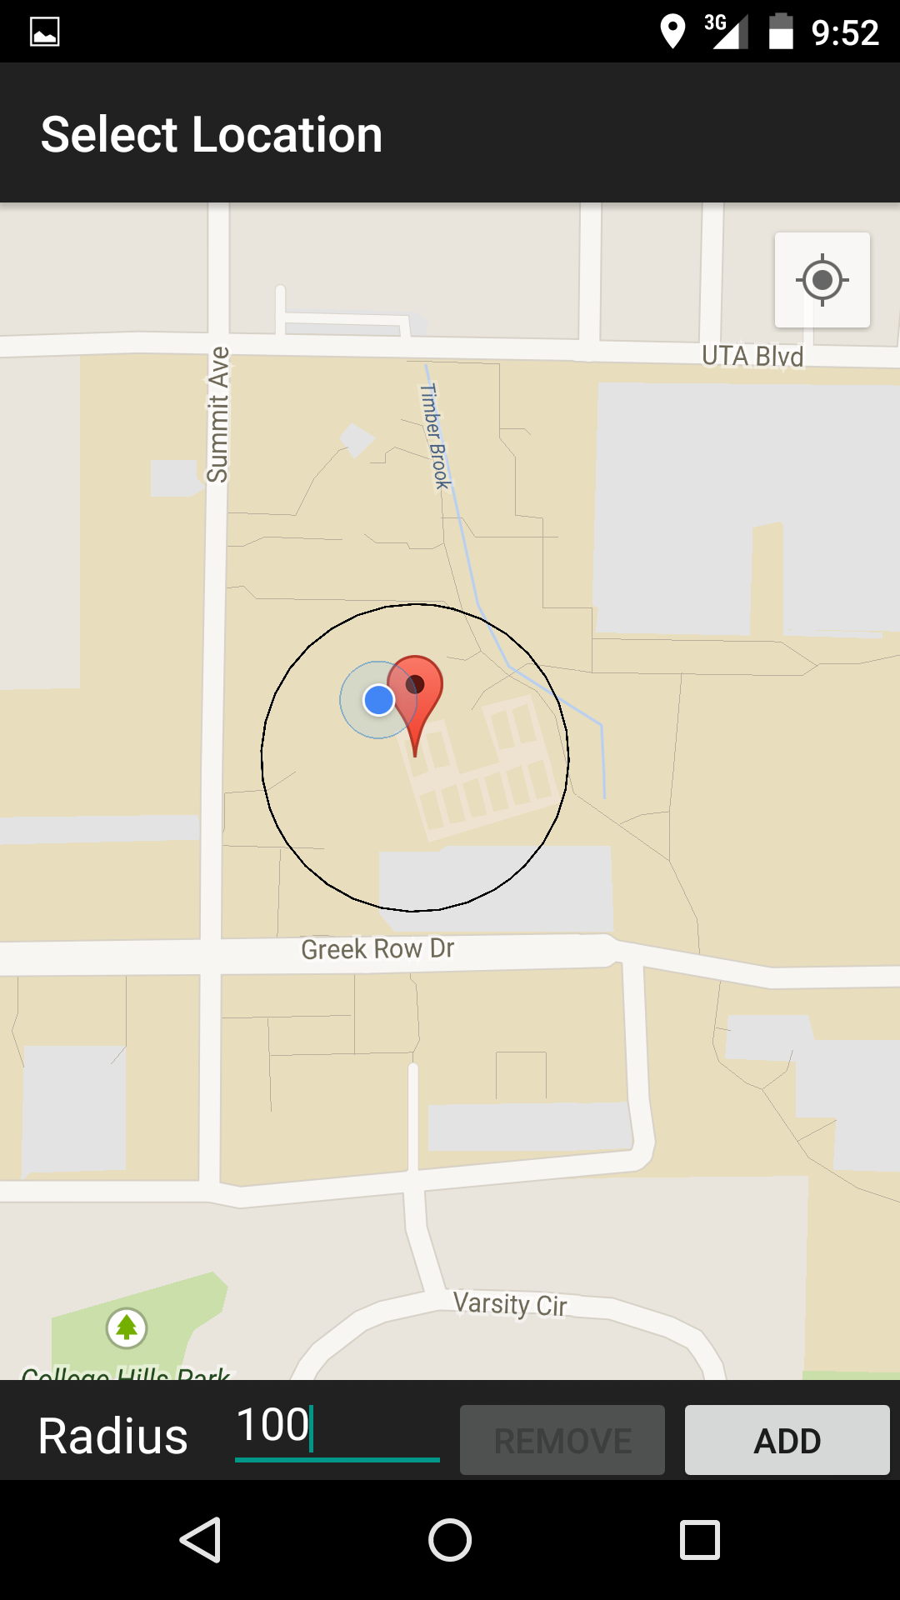
Code Walkthrough
Background functions for geofence location
Update Database
Geofence transitions

